Slide 1
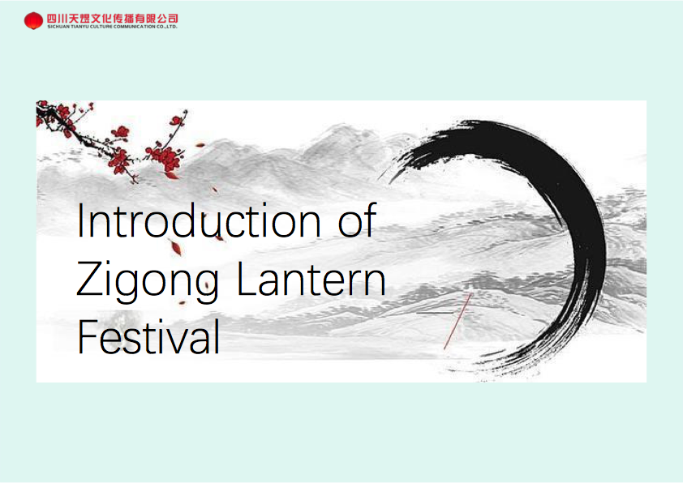

Slide 2
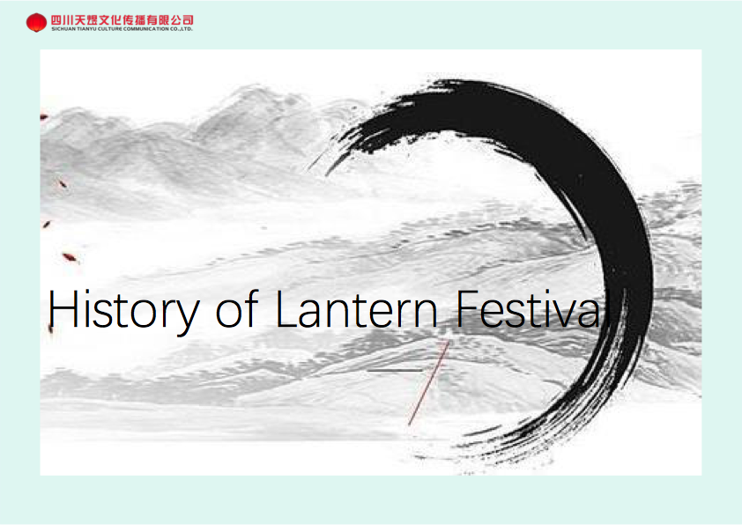

Slide 3
History of the Festival: https://www.youtube.com/watch?v=qfQAgA9VNog
7 min video and author interjects words in Chinese.

Slide 4
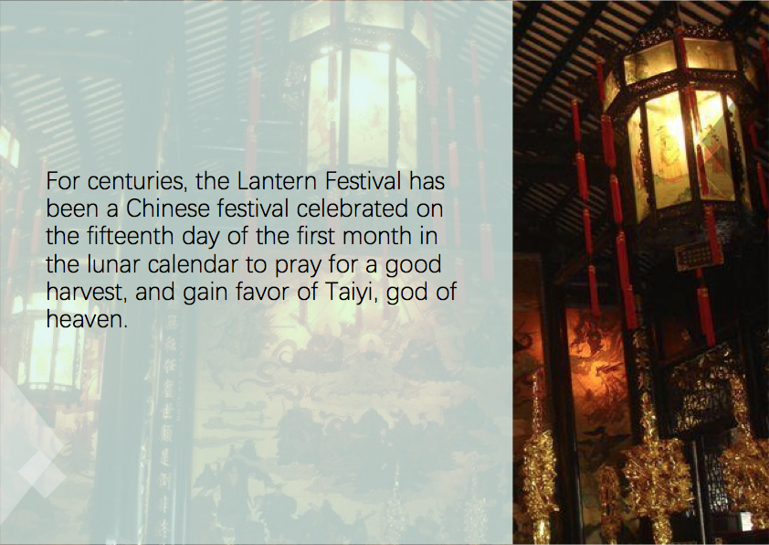

Slide 5
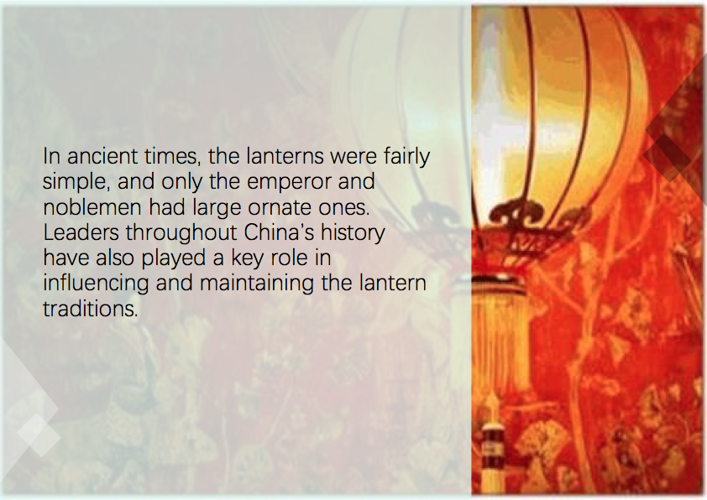

Slide 6
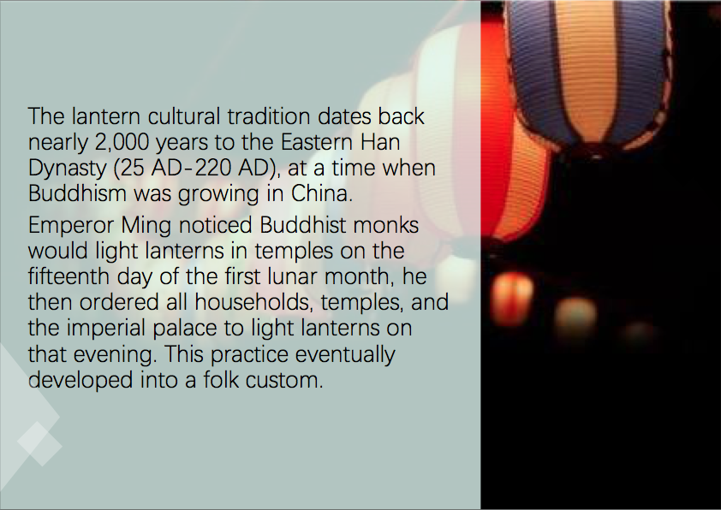

Slide 7
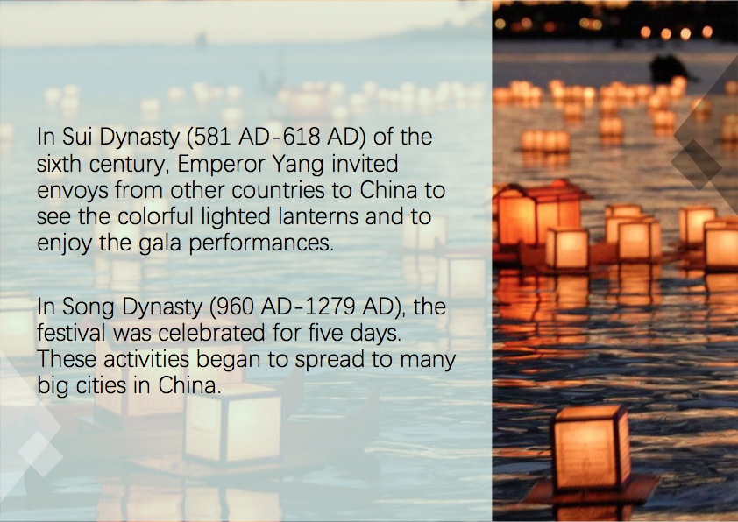

Slide 8
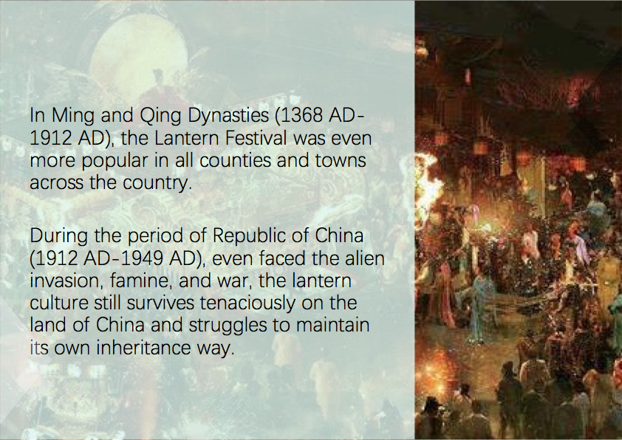

Slide 9
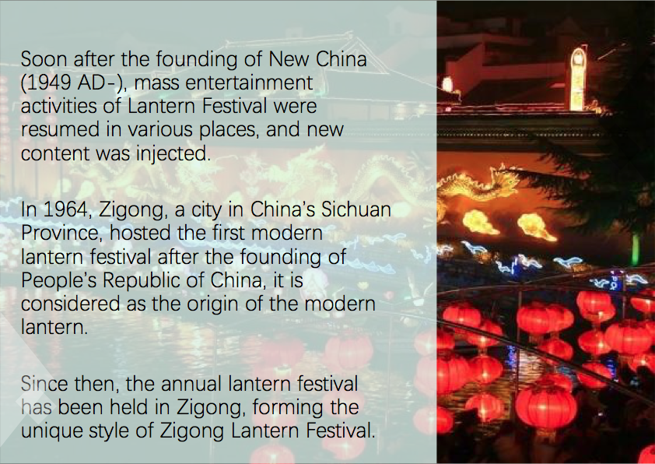

Slide 10
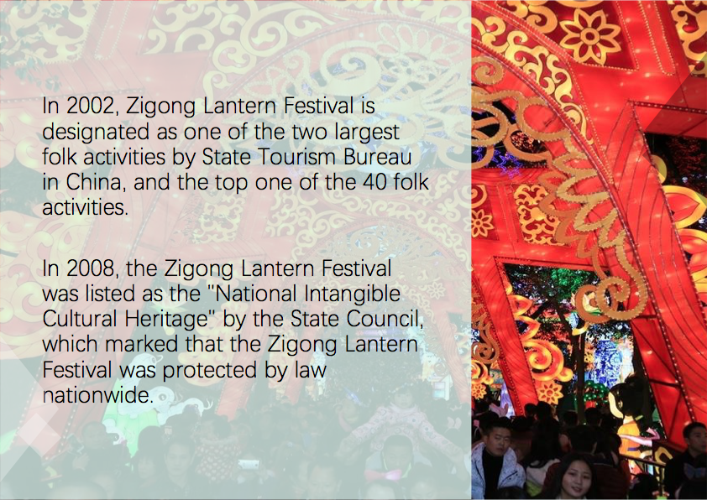

Slide 11
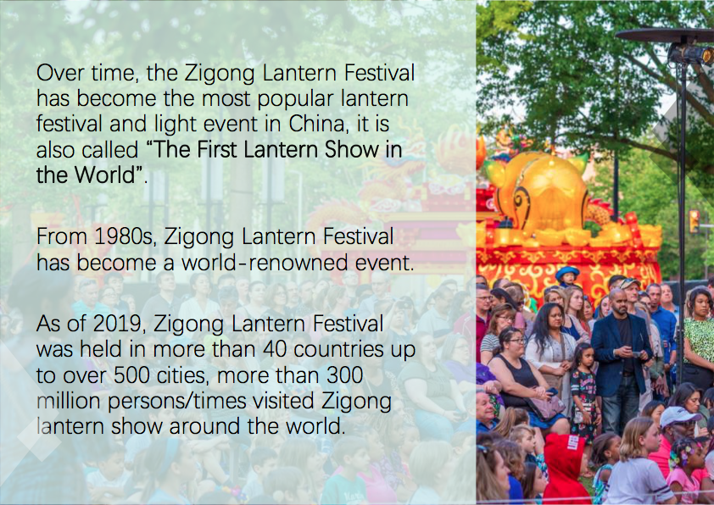

Slide 12
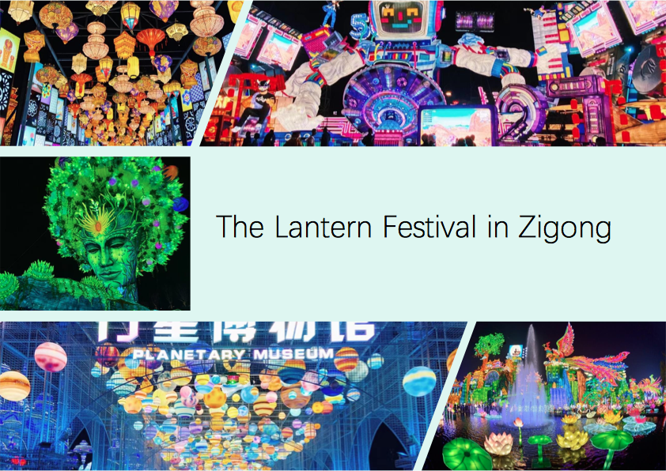

Slide 13
No words….
Video of Lantern festival (3 min video)
https://www.youtube.com/watch?v=XE-p-vyLKH4
Video of Zignong Festival in China (13 min)
https://www.youtube.com/watch?v=NpRUl63vnUY

