Slide 1
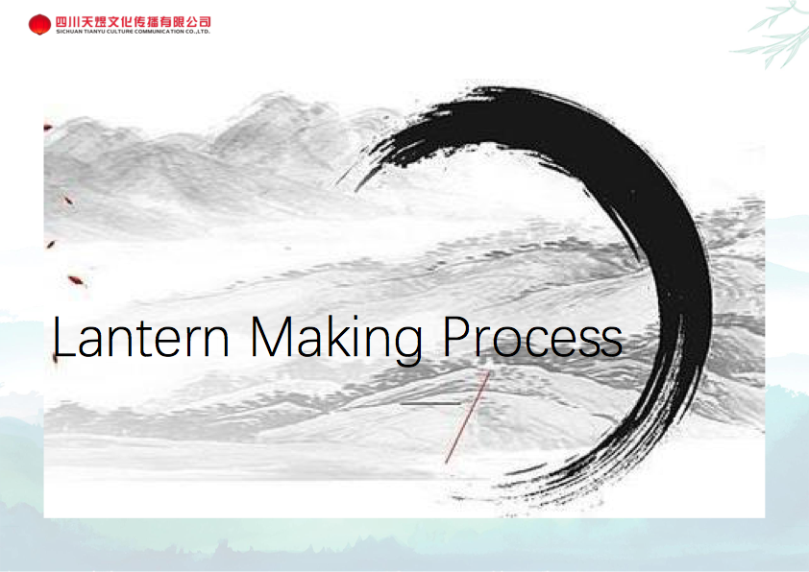

Slide 2
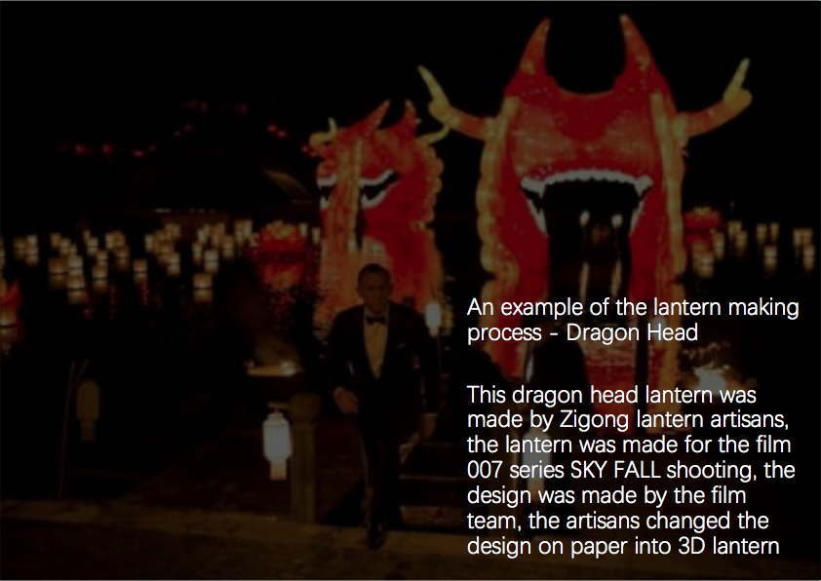

Slide 3
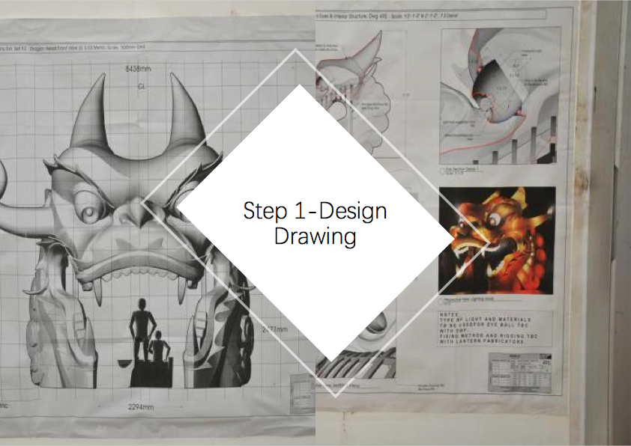

Slide 4
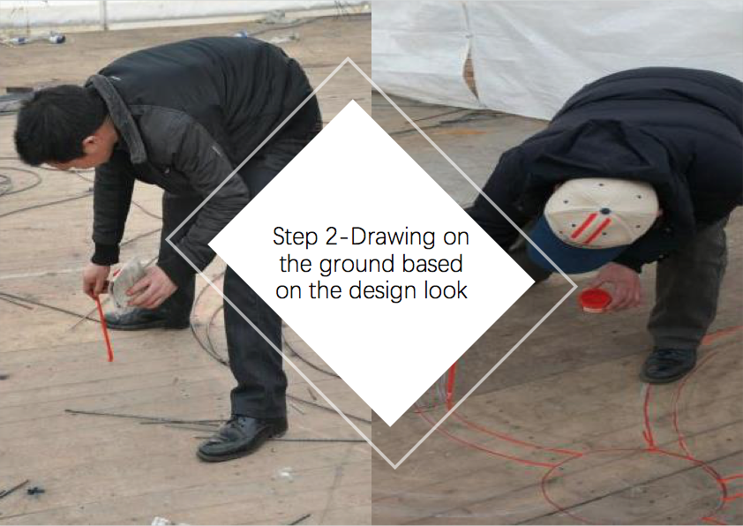

Slide 5
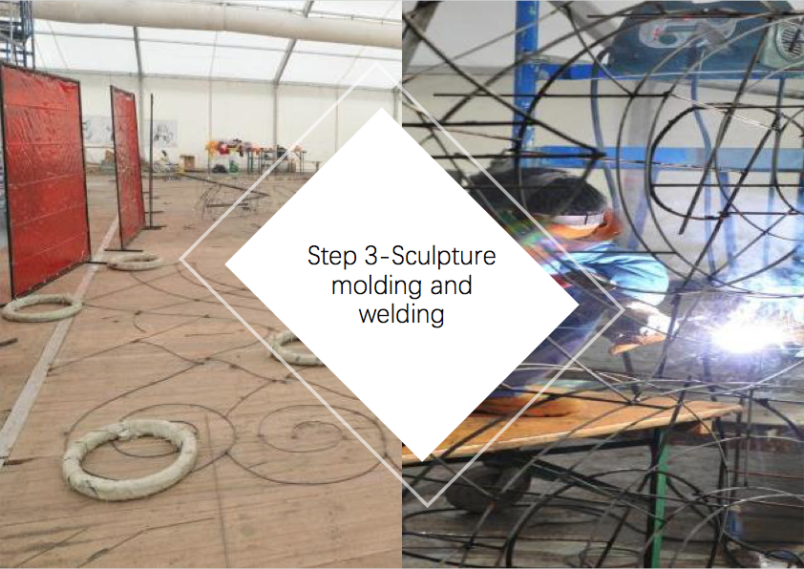

Slide 6
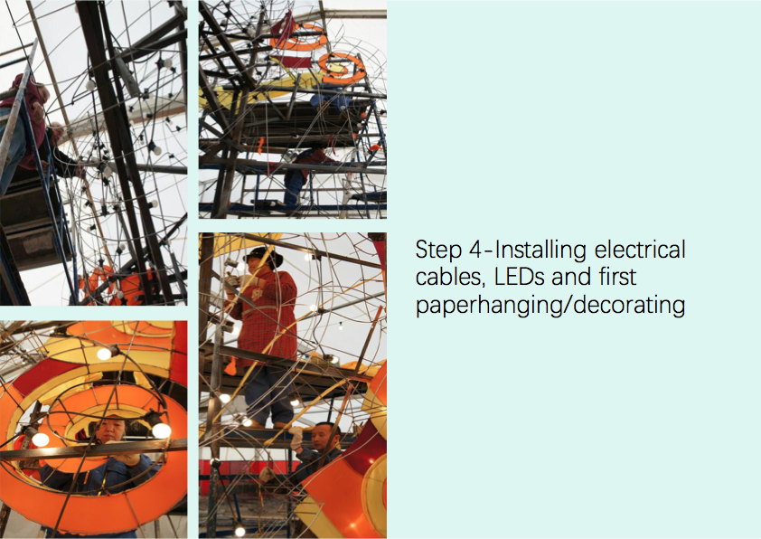

Slide 7
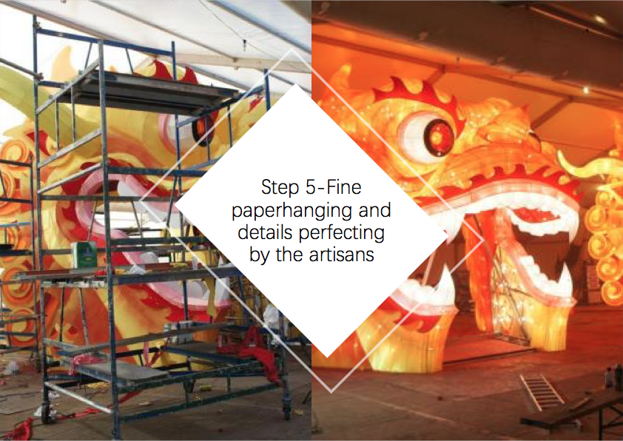

Slide 8
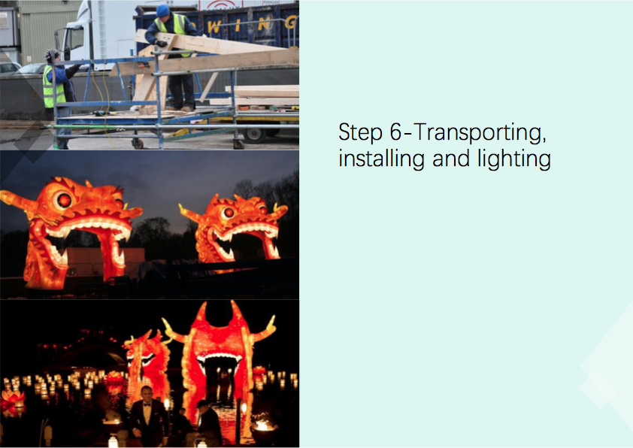

Slide 9
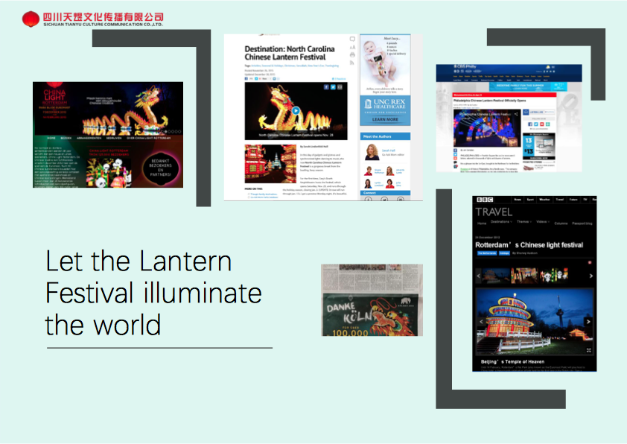

Slide 10
Video of behind the scenes in Zigong. This video is completely in Chinese, but one can get the sense of what it entails to create.
https://www.youtube.com/watch?v=oABINggTw6Q
This video is in english and chinese. There are subtitles that younger students will need someone to read it to them. Great video as you are with artisans to see how they create a lantern. 11 min. video
https://www.youtube.com/watch?v=PfseDlYZsUc&t=88s

