Slide 1
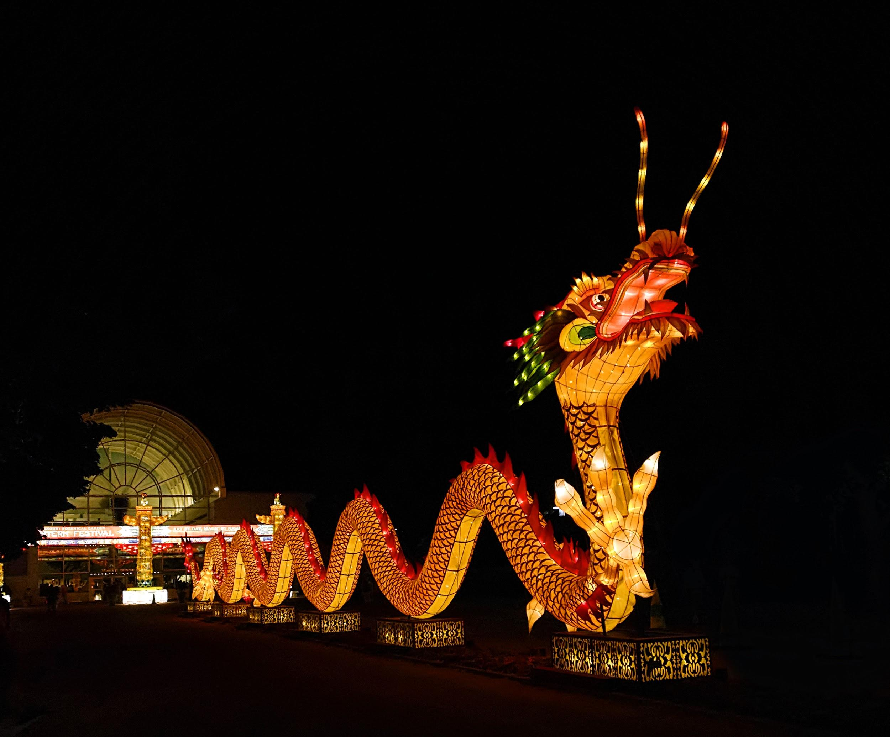
All About Lanterns
Notes:
Image Source: https://docs.google.com/presentation/d/1X60sprsC0zfADRXpGkgSysXFSINwJBhOdb6qqvUope4/edit#slide=id.p

Slide 2
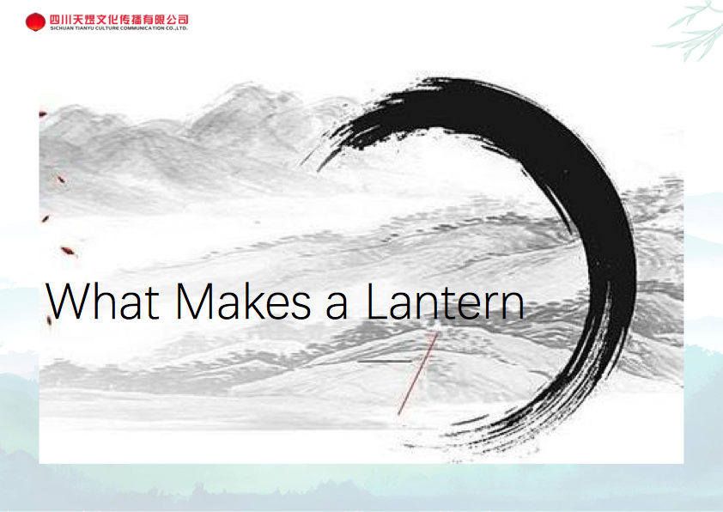

Slide 3
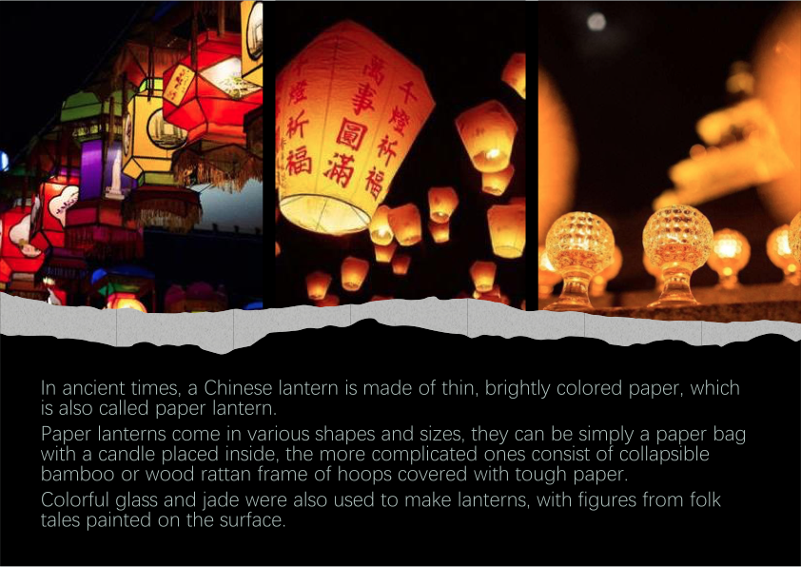

Slide 4
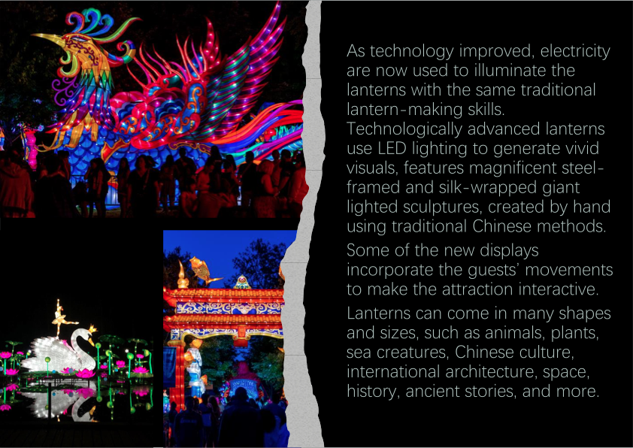

Slide 5
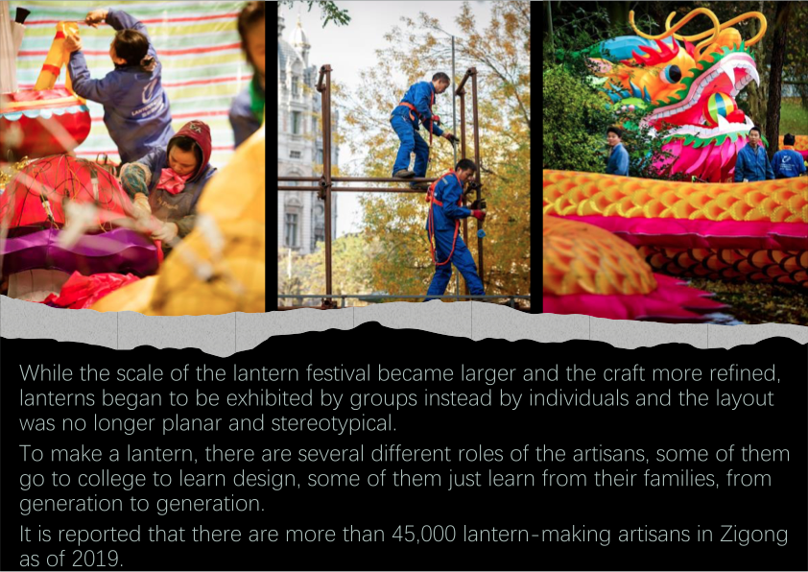

Slide 6
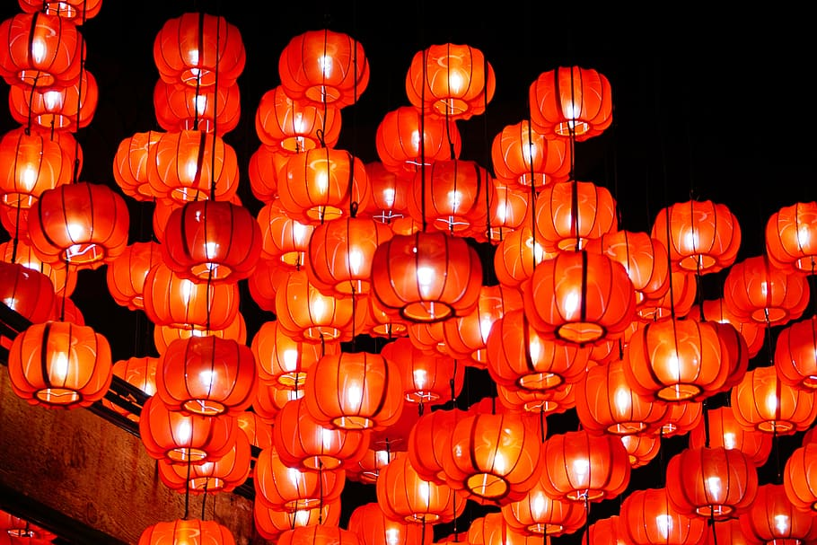
Some even have riddles attached to them.Solving the riddles were thought to be highly difficult. Are you ready to try some?
Notes:
Image Source: https://docs.google.com/presentation/d/1X60sprsC0zfADRXpGkgSysXFSINwJBhOdb6qqvUope4/edit#slide=id.ge198042ce2_0_1

Slide 7
Here we go:
Riddle #1
What is it that everybody does at the same time?
Riddle #2
One east, one west, they ie without seeing each other.
Riddle #3
What building has the most stories?
Grow older
Ears
Library

Slide 8
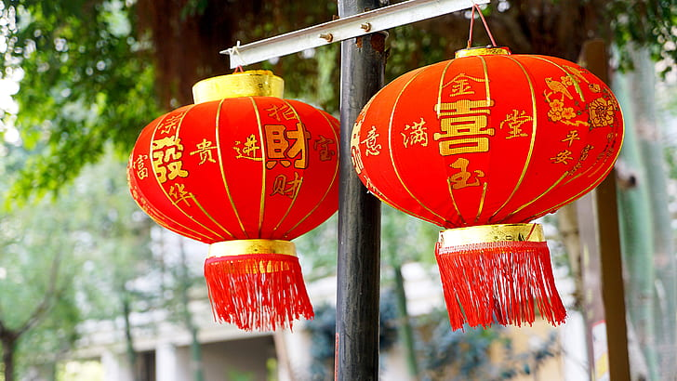
There are 3 different types of lanterns used throughout China:
Hanging Lanterns
The most common type of lantern is the hanging variety. These decorative lanterns are hung in both homes and public spaces. In cities and in rural areas, you can see lanterns adorning street lights, public buildings, and shops. Many homes will also sport a few decorative lanterns in their windows, especially during festival seasons.
Lanterns hung at Chinese New Year are thought to scare aware the Nian monster and bring good luck.

Slide 9
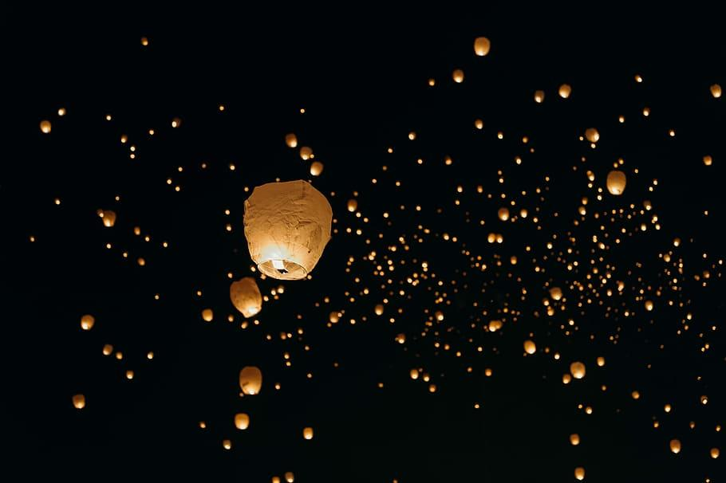
Flying Lanterns
On special occasions, such as the Mid-Autumn Festival, you can see a unique type of floating lantern being released into the night skies over China. These airborne lanterns are propelled by rising hot air generated by the flame within. They are beautiful to watch and are often released in large groups for a more eye-catching effect.

Slide 10
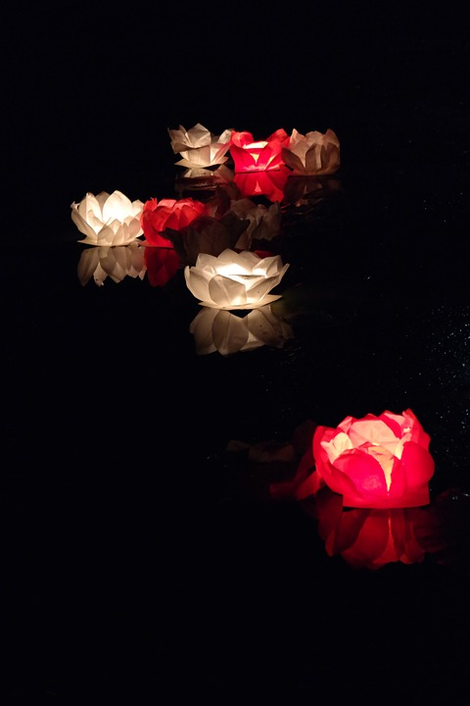
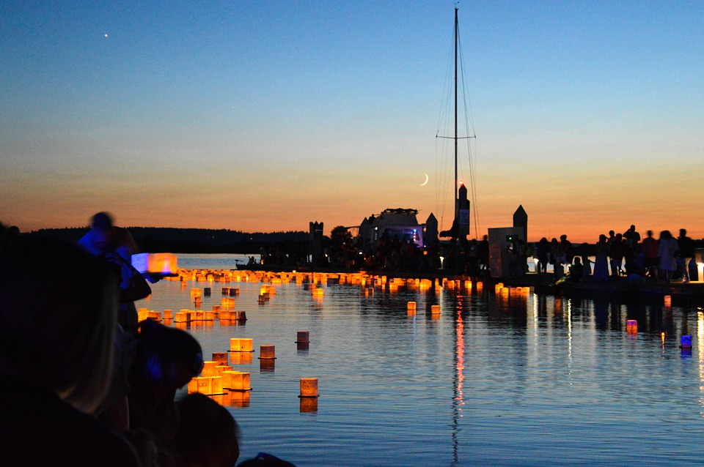
Floating Lanterns
Lantern celebrations, such as the Dragon Boat Festival, that take place near rivers, ponds, and lakes will often feature floating lanterns. This variety comes in many different shapes, such as the lotus design featured here. They are lit and put adrift in large groups to create a beautiful spectacle on the water.

