Slide 1
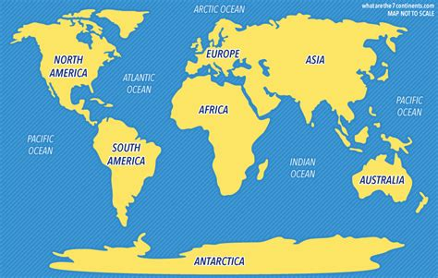
Notes:
Image Source: https://www.whatarethe7continents.com/

Slide 2
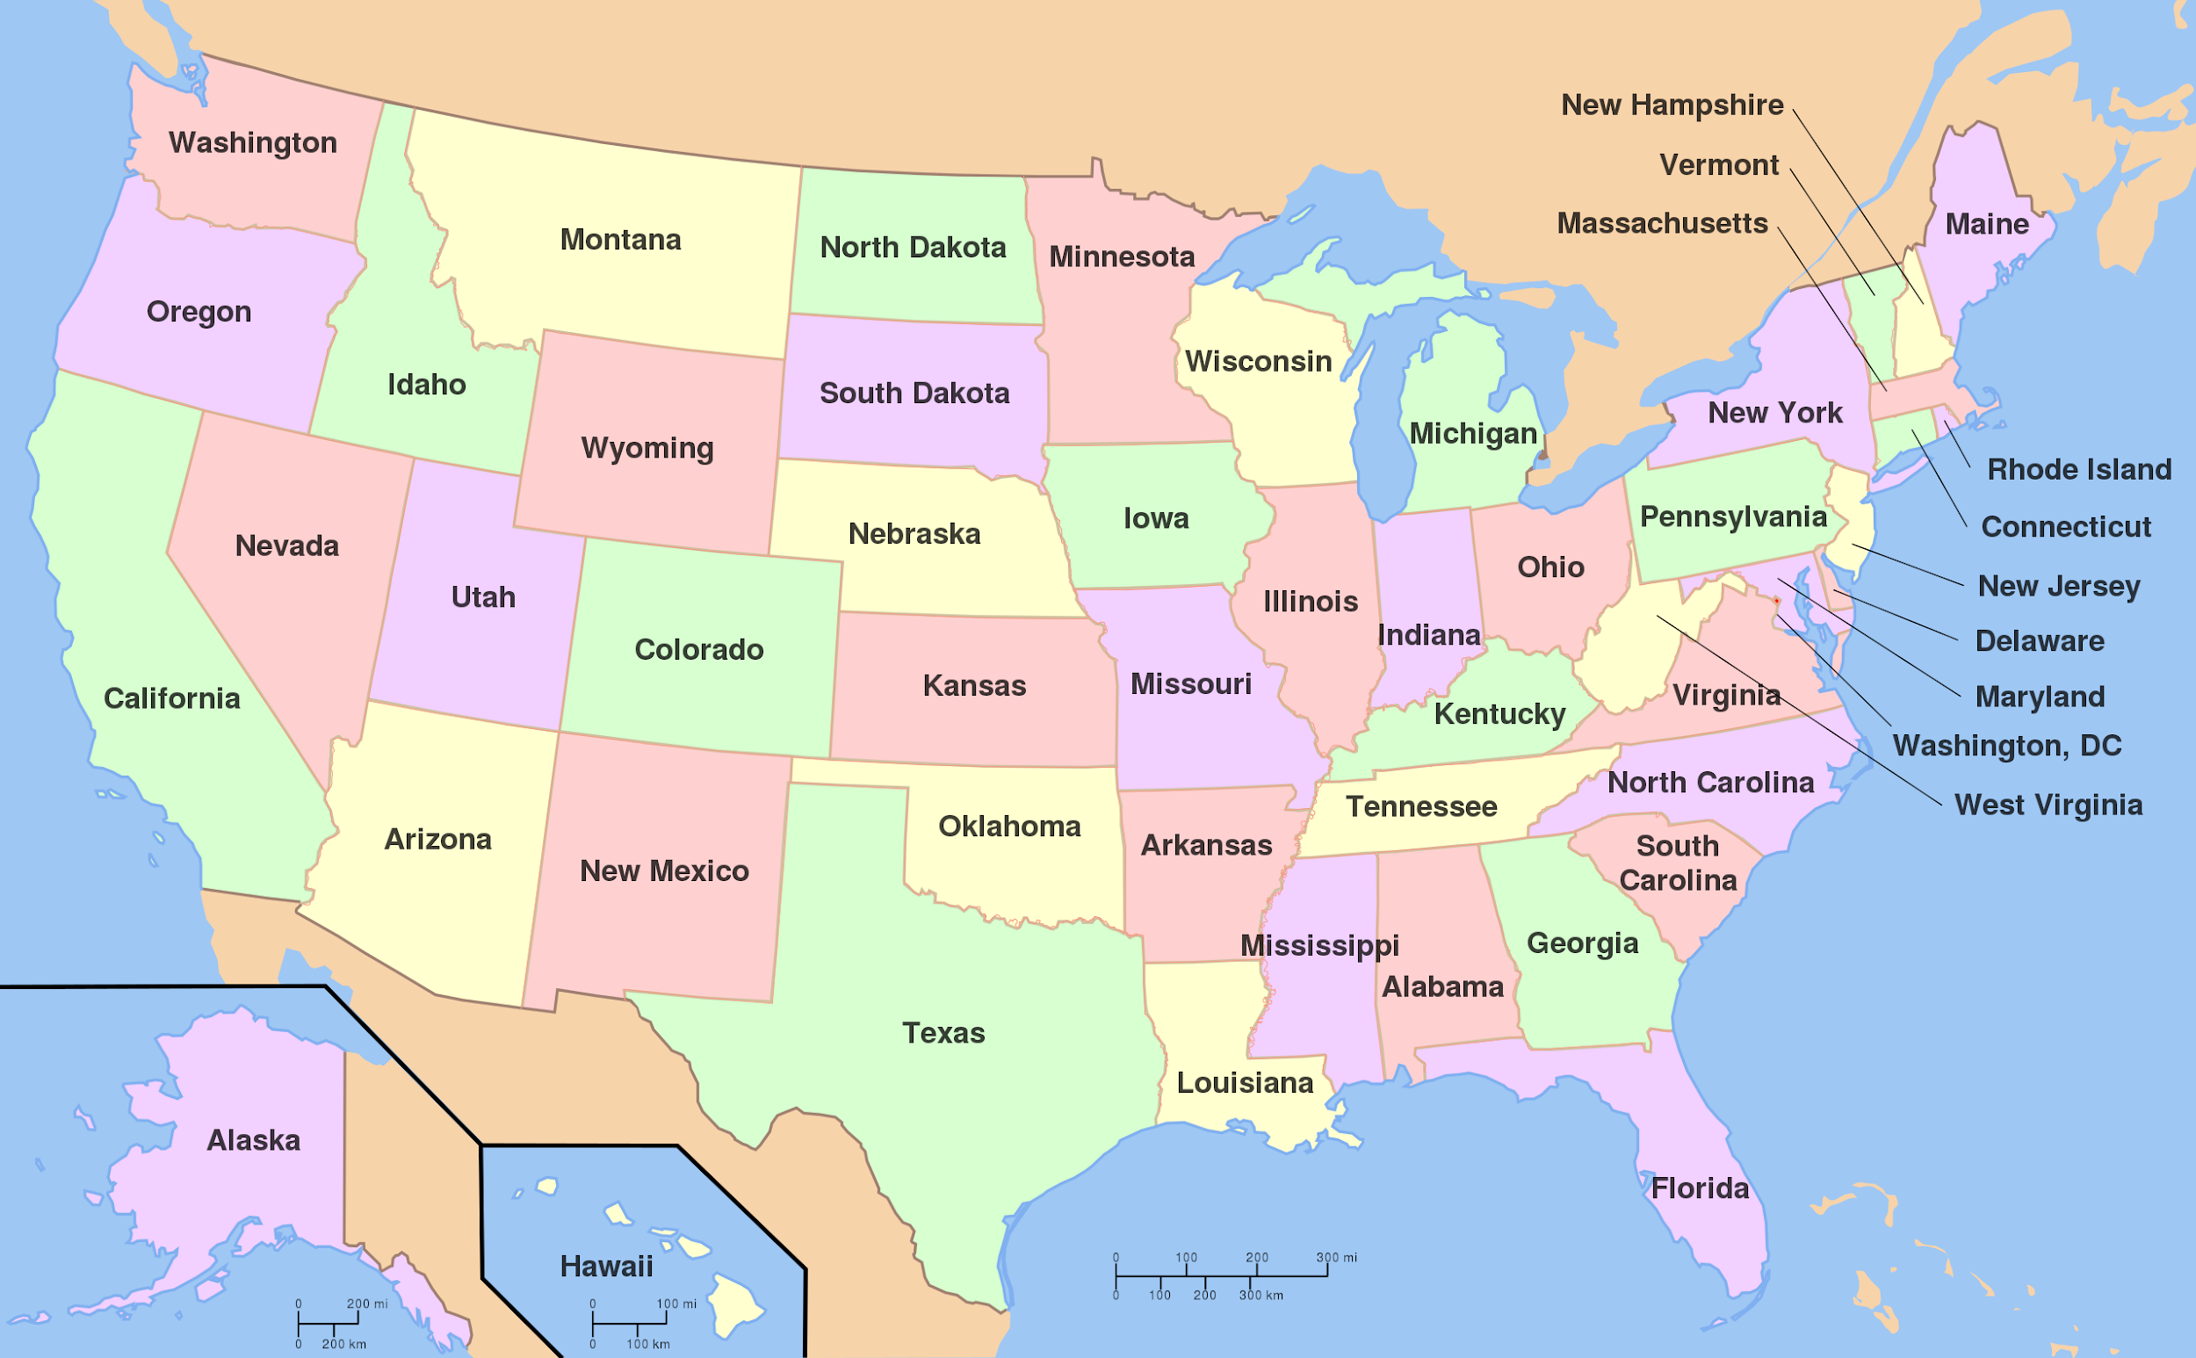
Notes:
Image Source: https://upload.wikimedia.org/wikipedia/commons/1/1e/Map_of_USA_showing_state_names.png

Slide 3
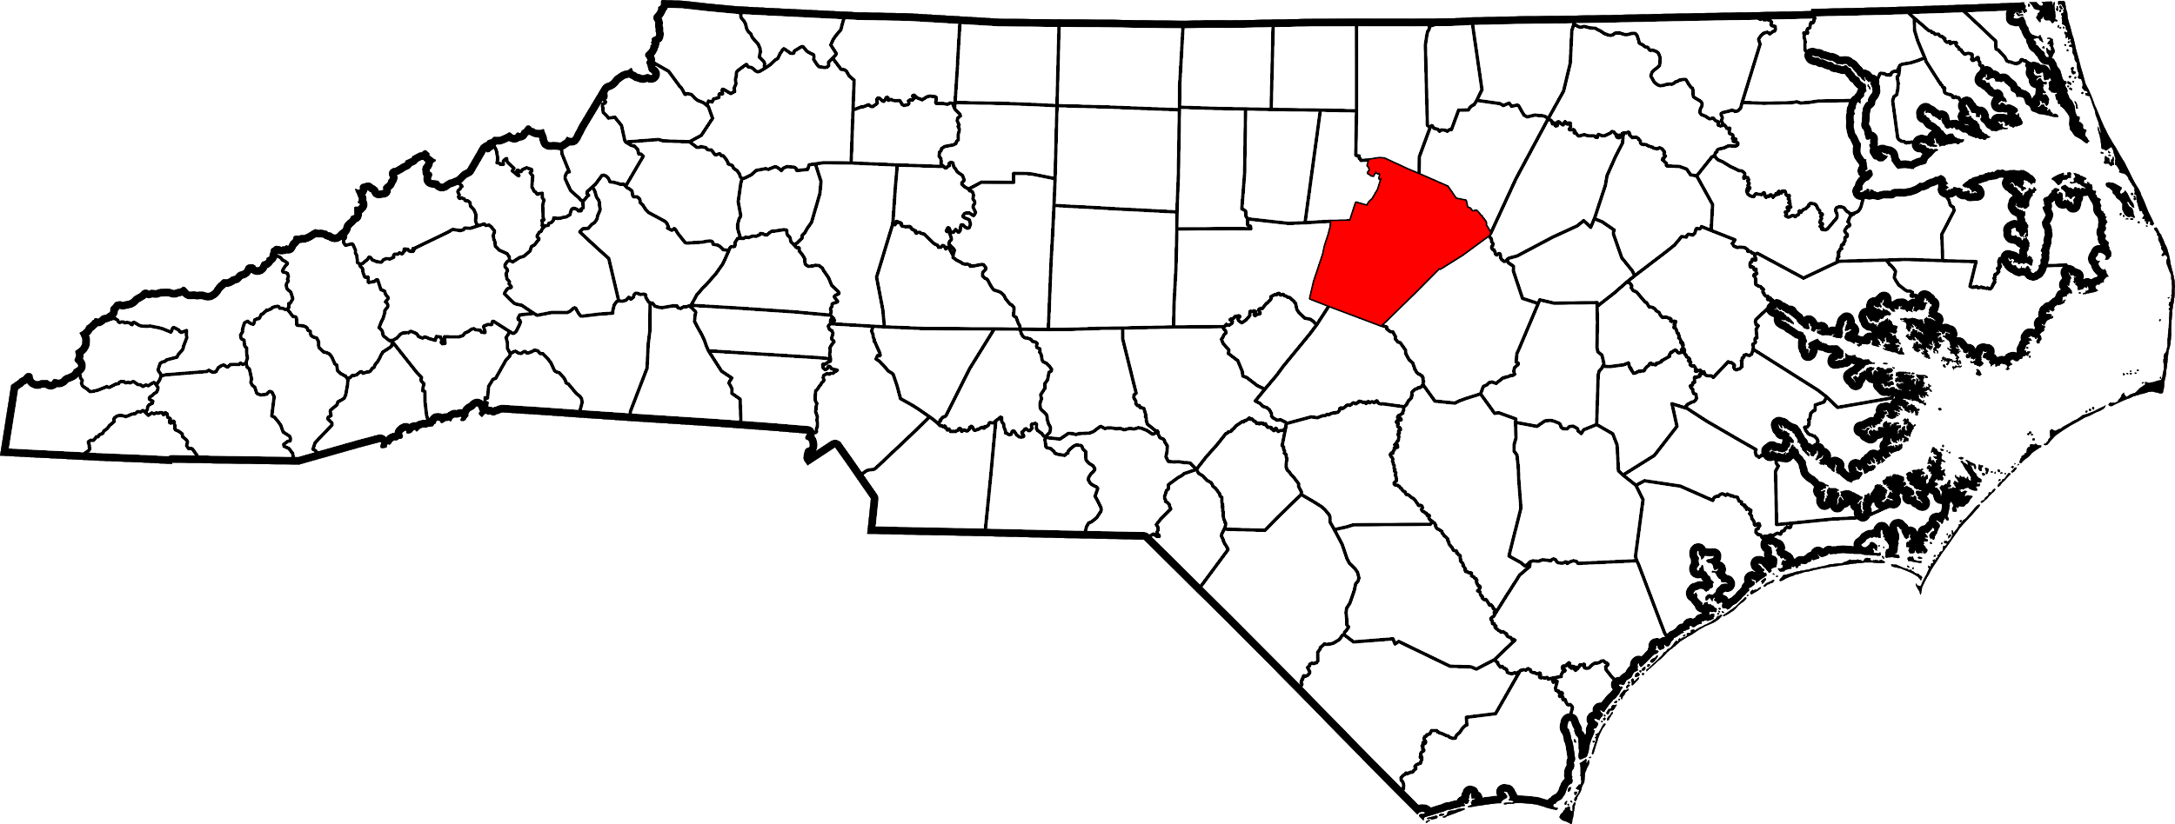
Wake County is the county where Koka Booth Amphitheatre and the Chinese Lantern Festival is located.
Notes:
Image Source: https://pl.m.wikipedia.org/wiki/Plik:Map_of_North_Carolina_highlighting_Wake_County.svg

Slide 4
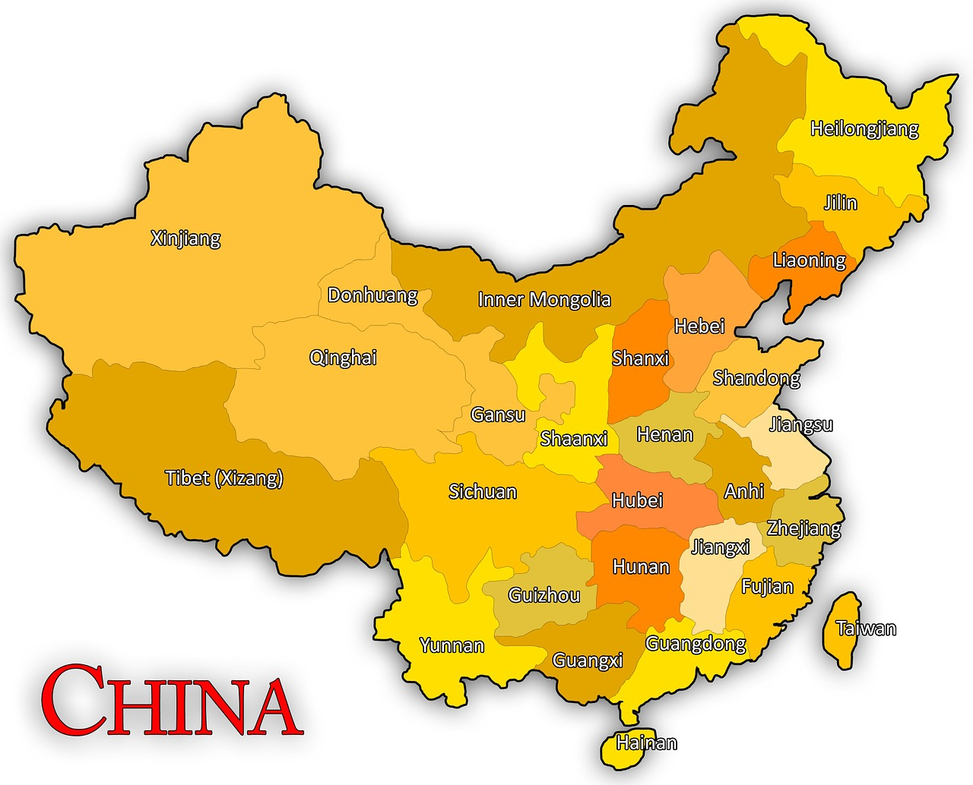
Notes:
Image Source: https://www.maxpixel.net/China-World-China-Map-Map-Globe-Asia-Chinese-1356803

Slide 5
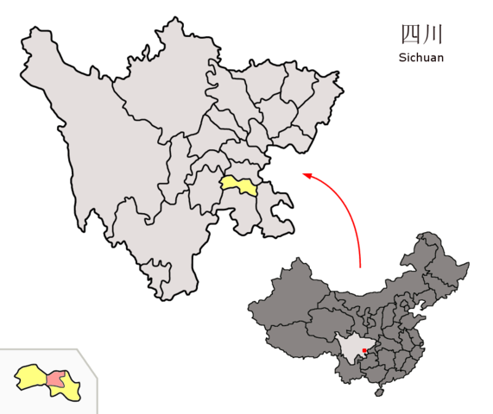
Zigong
Notes:
Image Source: https://commons.wikimedia.org/wiki/File:Location_of_Zigong_Prefecture_within_Sichuan_(China).png

